Slide 1
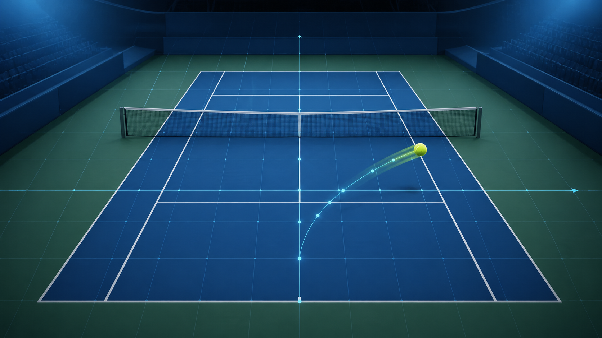
PROPOSAL PROJECT
Deep Learning-based Automated Tennis Tracking System for Line Calling
Automated ball tracking, bounce detection, court projection, and in/out decision-making from standard broadcast video.
Trần Ngọc Hùng · Data Science · Academic Year 2025–2026
01

Slide 2
Project Motivation
Automated Tennis Line Calling Proposal
Why this problem matters
Problem
Research gap
Goal
Broadcast tennis videos are easy to access, but they are not designed for millimeter-level line calling. The system must infer the ball landing position from 2D footage.
Commercial systems rely on specialized multi-camera setups. This project studies a lower-cost, deep-learning approach using standard 30 fps broadcast video.
Build an end-to-end prototype that tracks the ball, detects bounce, maps coordinates to court space, and outputs In/Out decisions.
02

Slide 3
Main Technical Challenges
Automated Tennis Line Calling Proposal
The difficult parts of broadcast-video line calling
Tiny object size
Motion blur
Occlusion
2D ambiguity
The ball occupies only a small number of pixels, especially from far broadcast cameras.
High ball speed and 30 fps video make precise localization difficult.
The ball can be hidden by player body, racket, net, or camera compression artifacts.
Single-camera video lacks direct depth, so geometric mapping is needed.
Detection
Tracking
Bounce frame
Court mapping
In/Out
Every stage amplifies localization error, so the design emphasizes robust tracking and calibrated projection.
03

Slide 4
Proposed System Architecture
Automated Tennis Line Calling Proposal
End-to-end pipeline from video frame to decision
Broadcast Video
Ball Tracking
Court Mapping
Bounce Detection
In/Out Decision
Input 30 fps match footage
S-KeepTrack-style small object tracking
Keypoints + homography to 2D court
Trajectory and velocity time-series model
Projected bounce point vs court lines
Design principle: separate the task into interpretable modules so each error source can be measured and improved independently.
04

Slide 5
Dataset: TrackNet Tennis
Automated Tennis Line Calling Proposal
Ball position labels from broadcast video
1280×720
30 fps
~75 min
81
20,844
video resolution
broadcast frame rate
match video duration
game-related clips
annotated frames
Source and annotations
Why it fits this project
TrackNet uses the 2017 Summer Universiade men’s singles final and provides frame-level ball coordinates, visibility class, and trajectory information.
The dataset directly reflects the target condition: high-speed tiny ball tracking from ordinary broadcast tennis video.
05

Slide 6
Ball Tracking Model: S-KeepTrack
Automated Tennis Line Calling Proposal
Tracking tiny and fast-moving objects
High-level branch
→
Association Net
semantic appearance features
candidate matching matrix S
Frames
→
↘
Fusion
→
Track
t−1 and t
S* = ωS + (1−ω)S̄
final ball state
Low-level branch
Association Net
↗
→
fine local features for tiny ball detail
candidate matching matrix S̄
Key adaptation for this project: use both low-level and high-level features so the model can preserve small-object details while keeping discriminative appearance matching.
06

Slide 7
Court Detection and Geometric Mapping
Automated Tennis Line Calling Proposal
Project image coordinates onto a 2D tennis court
Keypoint model
Homography
EfficientNetV2-Small predicts court landmarks from video frames.
Map image-space coordinates to a standardized 2D court plane.
Ball projection
Line distance
Transform tracked ball coordinate at bounce frame.
Compare projected bounce point against court boundaries.
07

Slide 8
Bounce Detection
Automated Tennis Line Calling Proposal
Use trajectory dynamics instead of single-frame evidence
Features
x, y, velocity, acceleration, visibility class
predicted bounce frame
Model
Time-series classifier over a short frame window
Output
Bounce / non-bounce probability per frame
08

Slide 9
In/Out Decision Logic
Automated Tennis Line Calling Proposal
Convert perception into a transparent rule-based decision
1
Locate ball at bounce frame
2
Project ball point onto court plane
3
Measure point relative to active court lines
projected bounce point
4
Return In / Out + confidence
The final decision layer is intentionally explicit: the model estimates coordinates, then deterministic geometry evaluates the line call.
09

Slide 10
Evaluation Plan and Expected Outcomes
Automated Tennis Line Calling Proposal
How success will be measured
Tracking evaluation
Bounce evaluation
Line-call evaluation
Ball localization error, detection precision/recall, robustness under motion blur and occlusion.
Frame-level bounce classification accuracy, F1 score, and tolerance around true bounce frame.
Correct In/Out decision rate and distance-to-line sensitivity analysis.
Data prep
Tracking model
Court mapping
Bounce model
Integration demo
Final deliverable: an end-to-end prototype with documented methodology, trained models, evaluation results, and a demo video.
10

